Slide 1




Promoting the Language and Literacy Learning of Young Children Experiencing the Stresses of Poverty
Charles R. Greenwood, PhD
Juniper Gardens Children’s Project,
University of Kansas
October 15, 2020
Presentation to the combined Virginia Cross-Sector Professional Development Faculty Institute and the OSEP Project KSR symposium.

Slide 2
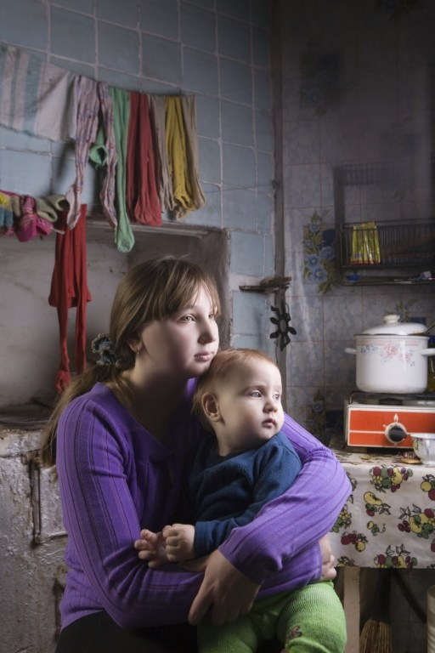
Today’s Talk - Promoting Language and Literacy Learning
How poverty stress creates inequity in children’s learning
How to support language and literacy promotion
  Parents
  Teachers, nonparental caregivers
  The entire community
Brief breakouts and reports back
Summary/Conclusion
Discussion Question
Online Resources/Contact Information

Slide 3

Big Ideas!
The Covid-19 Virus is the new challenge
Use intentional teaching
Create more opportunity to learn
Promote child engagement given opportunities
Alignment with CLASS
Use evidence to make intervention decisions
Differentiate instruction based on assessed progress

Slide 4

Poverty Stress is Toxic on Children’s Learning
National FACTS:
18% to 22% of young children are living in poverty (Kids Count Data Center, 2018)
Some will arrive ready for school; but on average most will not
Failure to reach “proficient” reading levels - National Statistics
  83% of children from low-income families
  85% attending poverty schools
  1 in 5 children with significant reading disability
  1 in 3 children are struggling readers

Slide 5
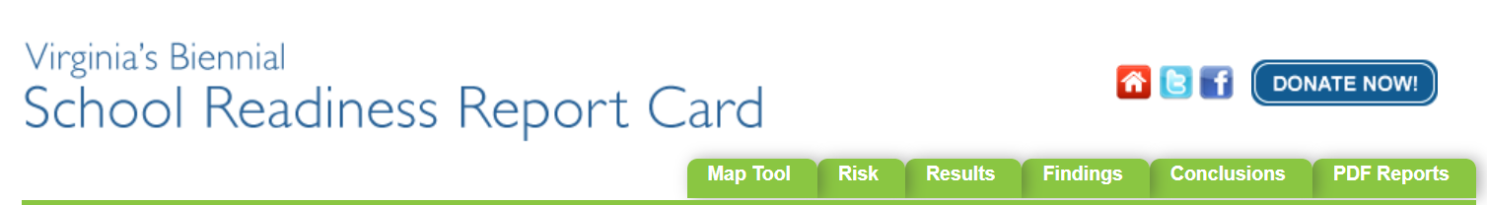
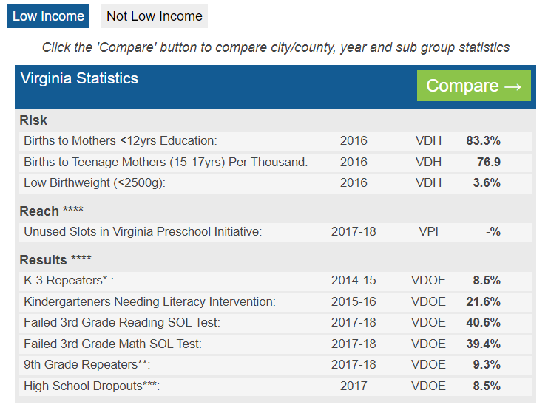
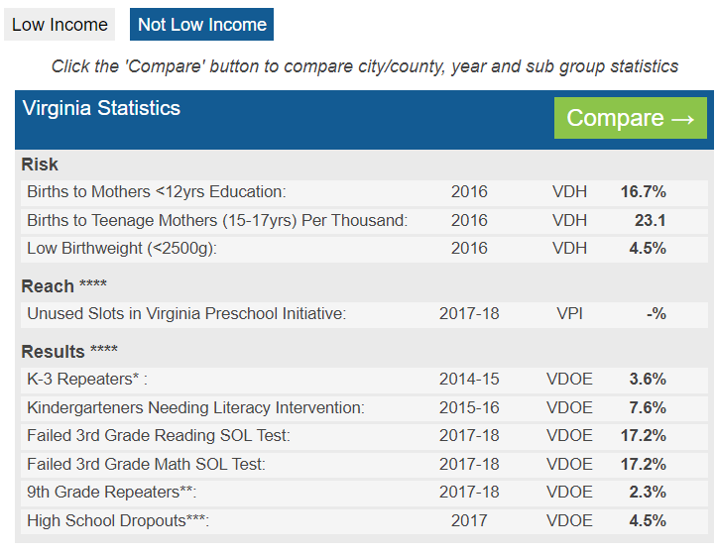
http://www.virginiareportcard.com/map.php

Slide 6
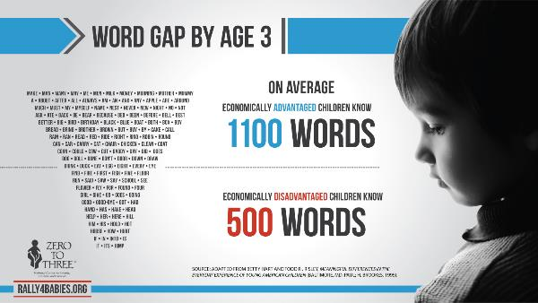
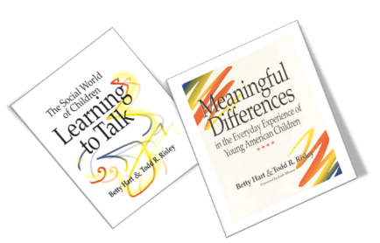
Research Facts: Children Reared in Poverty -
Have had fewer language and literacy experiences at home
Use fewer words in their vocabulary by 3-years of age
More likely to become struggling readers later

Slide 7
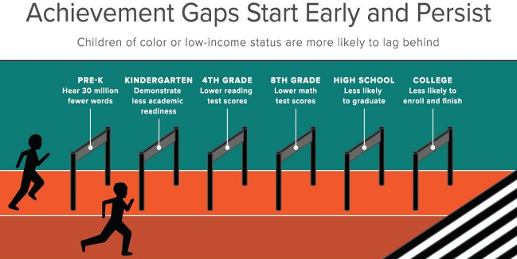

Slide 8
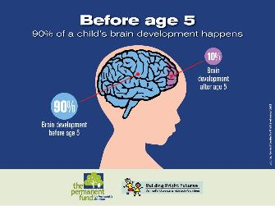
Healthy Early Childhood Development!
The brain develops most rapidly in the first few years of a child’s life.
Shaping the developing brain is the interchange between genes and experiences obtained in the environments where a child is born, grows, learns and lives
Thuse, the foundation is laid for:
  a child’s physical and mental health
  longevity and the lifelong capacity to learn
  resiliency against adverse circumstances

Slide 9

More Healthy Development!
Exposure to positive, language-rich environments underlies brain, vocabulary, and literacy development
Experiences are our interactions with parents, caregivers, teachers, and friends
Parents, caregivers, teachers have the power to create positive language rich environments
  by changing by how they talk with a child for longer episodes, occurring more often, and that follow a child’s interest
Conversely, exposure to modest-language, indifferent environments leads to lower outcomes

Slide 10

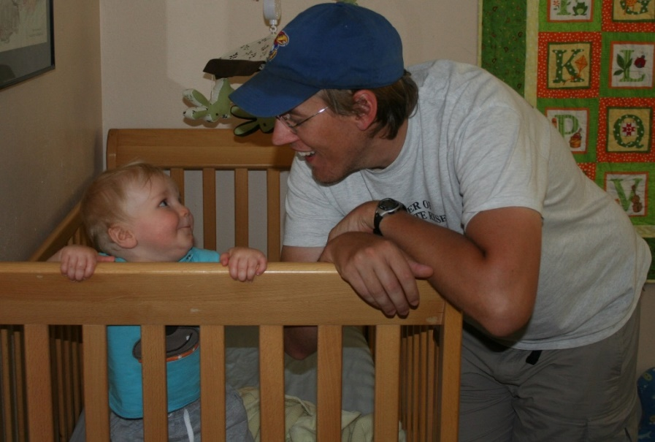
How to Support/Engage Parents

Slide 11

Challenges Parents Face
Having the knowledge
  talking builds a child’s brain and vocabulary (Language Nutrition)
Wasn’t given the message
  pediatrician, nurse didn’t say
Knowing what I should do
  How to do this stuff
Finding the time and daily coverage
  I’m at work, don’t have child care, the sole caregiver, no childcare program, etc.
Standing in the way are myths and my beliefs
  baby doesn’t talk to me, why would I talk to baby?; real learning starts in kindergarten, not infancy etc.!

Slide 12
How to Support Parents in Promoting Language and Literacy
Work to increase the positive conversations and responsive interactions that adults and caregivers engage in with children
Teach naturalistic conversation models, those that use the child’s interest and initiations as opportunities for adult input
Teach others to help parents learn these skills

Slide 13
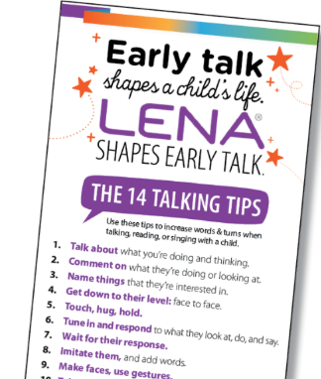
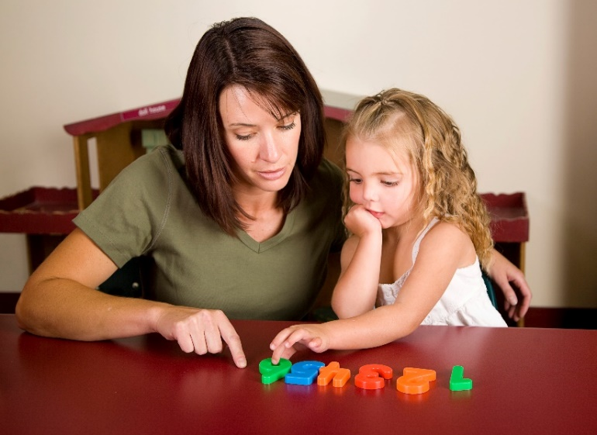
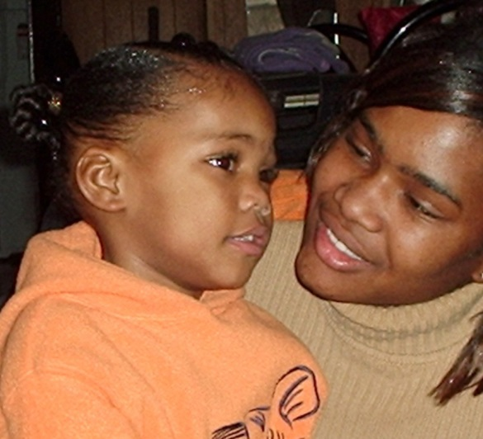

Slide 14
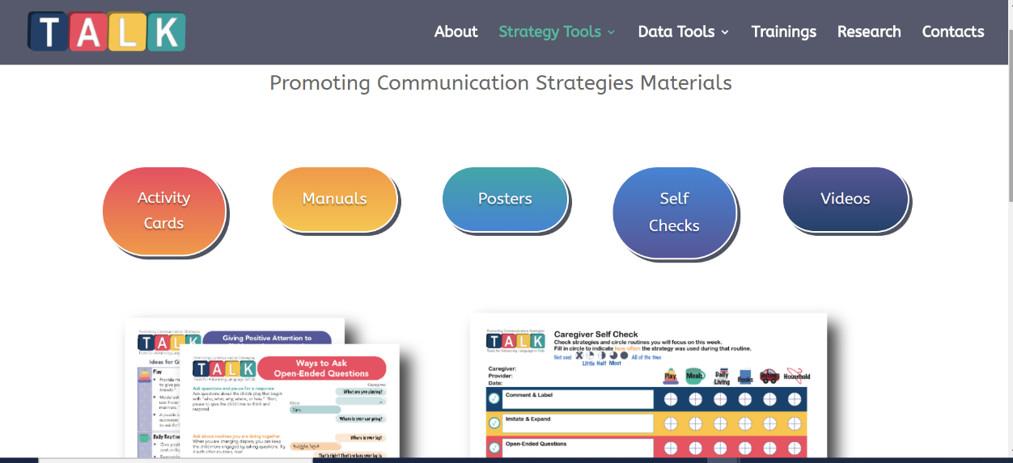
Tools for Advancing Language in Kids! https://talk.ku.edu/research/

Slide 15
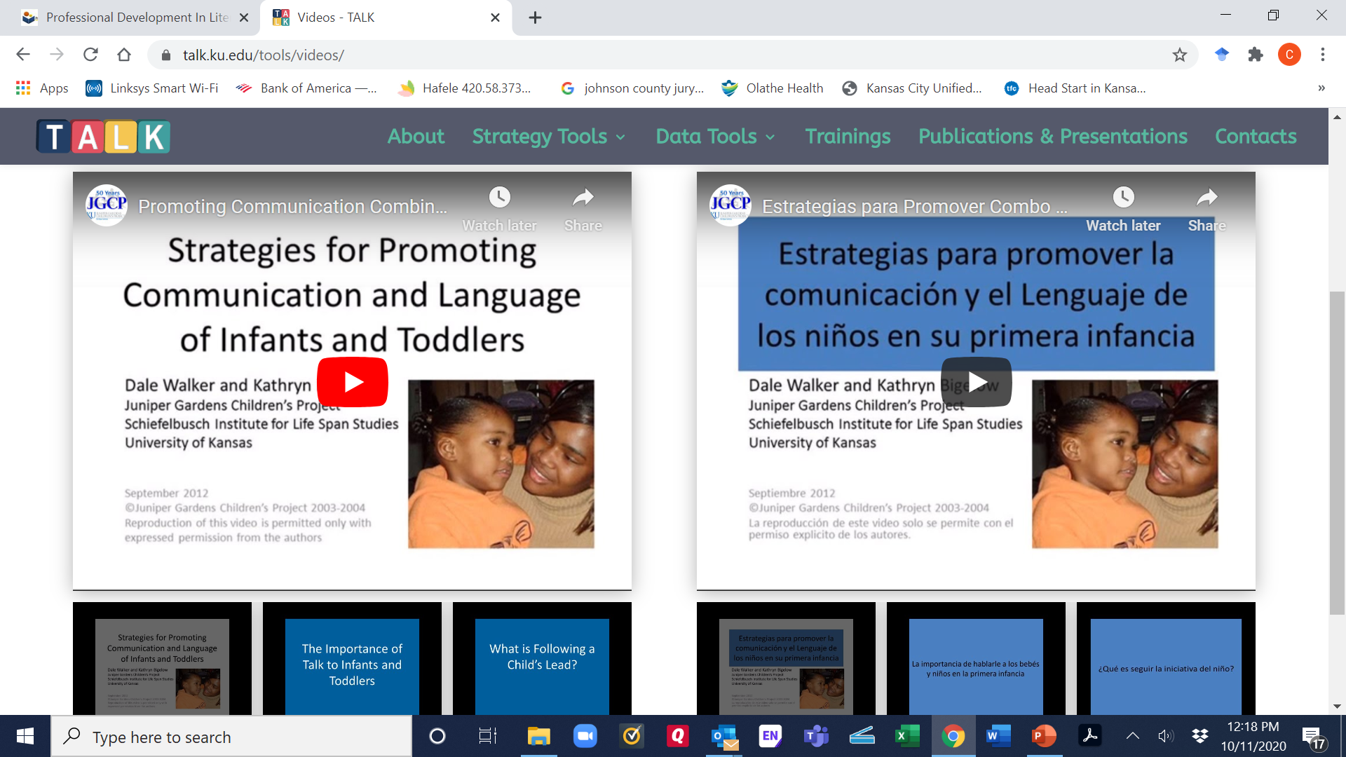

Slide 16
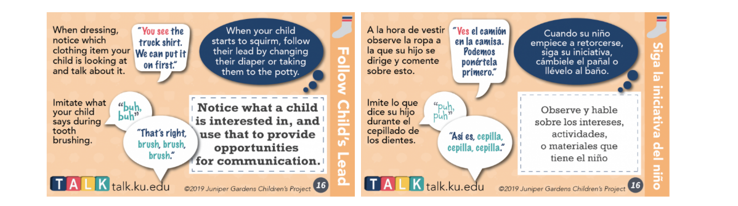
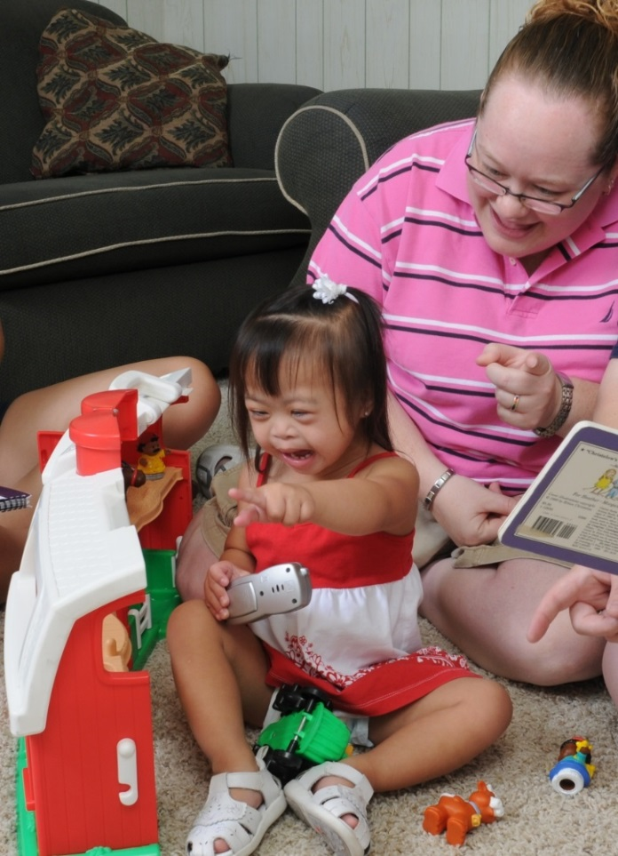
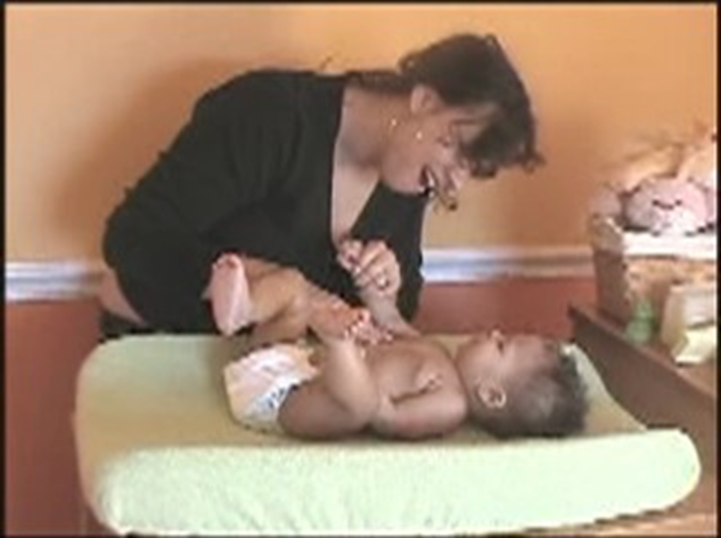
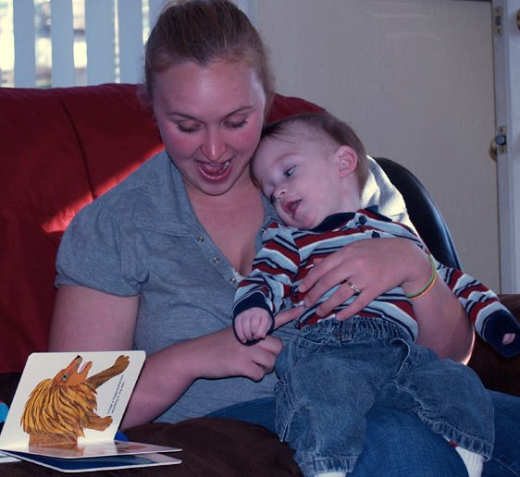

Slide 17
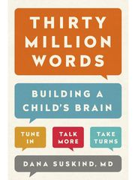

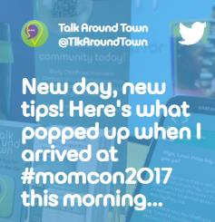
Tools/Resources
TALK https://talk.ku.edu/research/
LENA Foundation https://www.lena.org/
Talk Around Town App http://talkaroundtown.waypoint-platform.com/
Talk to Me Baby http://www.talkwithmebaby.org/

Slide 18
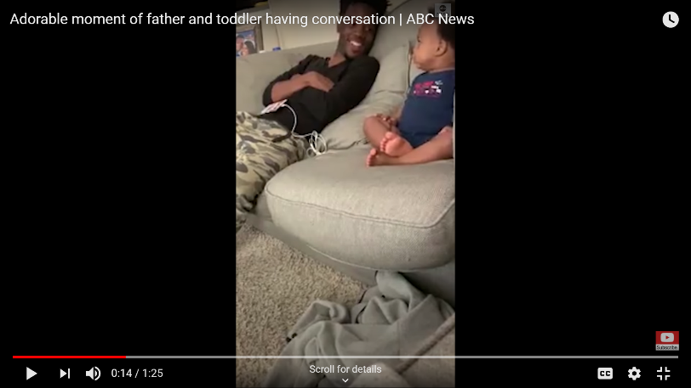
Video Clip Parent Talking to Baby
https://www.youtube.com/watch?v=Yn8j4XRxSck
Responsive Father-Son Conversation

Slide 19

Break-Out and Report Back
Identify the TALK strategies Dad uses in this clip
How can you teach them to others?

Slide 20

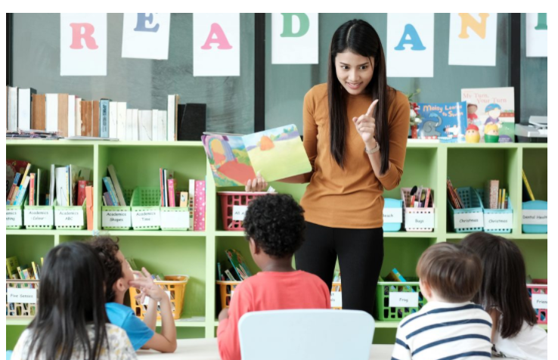
How to Support/Engage Teachers

Slide 21

Work to address the low levels of instructional support provided to children in:
Preschool programs (Greenwood et al., 2013; Justice, Hamre, & Pianta, 2008) and
Inclusive early childhood special education programs (Guo, Sawyer, Justice, & Kaderavek, 2013)

Slide 22
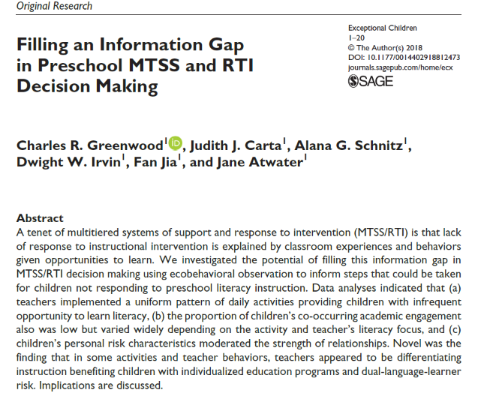
The Opportunity to Learn Literacy is Too Often Absent in Preschool

Slide 23
The Children’s Engagement in Literacy Behaviors is Too Often Missed and Variable

Slide 24
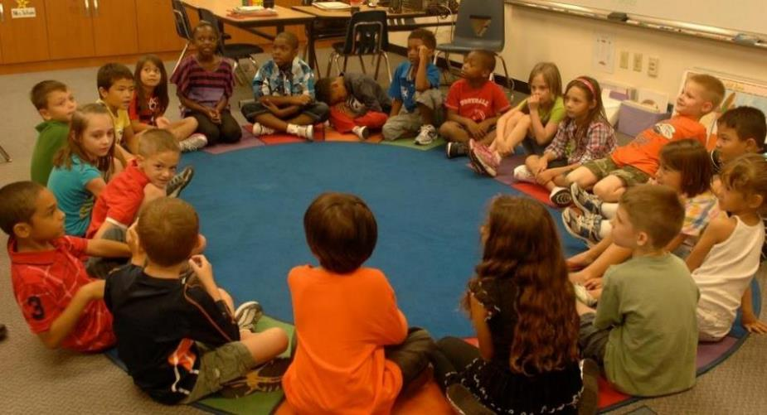
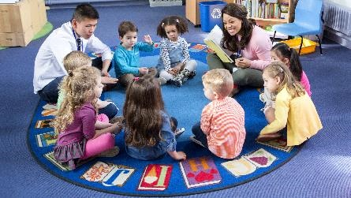
Too Much Time Doing This!
More Time Like This!

Slide 25
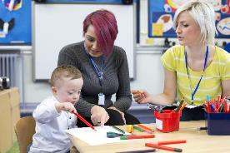
Challenges that Programs and Teachers Face
Children in a classroom present with a range of literacy skills
Programs and teachers are often not prepared to formally teach early literacy

Slide 26
Challenges that Programs and Teachers Face (Continued)
Few evidence-based, comprehensive early literacy curricula are available, and supported by professional development
Lacking actionable information on children’s progress and how to differentiate to meet the needs of individual learners
Just a lot to cover to meet standards (i.e., social-emotional and language and literacy outcomes and more)!

Slide 27


Literacy 3D – Data Driven Decisions
Literacy 3D is a multi-component professional development program designed to address the generally low level of instructional support commonly reported in early education
Uses evidenced-based instructional strategies with coaching implementation support

Slide 28
Literacy 3D
Increases children’s opportunities to learn and engage in literacy interactions with the teacher
Complements does not replace any early literacy curriculum
Ten teaching strategies that maximize teacher-student interactions and children’s opportunities to respond
Practice-based coaching support
Measurement strategies help differentiate instruction for children with IEPs and dual language learners (DLLs)
Tune-up checklist planning for change and fidelity of implementation

Slide 29
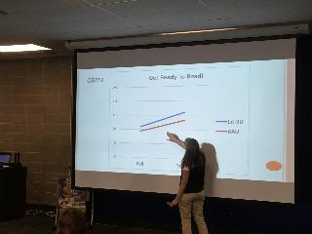
Professional Development
Six two-hour sessions with teachers in a school

Slide 30
Evidence-based Strategies
Simple Moderate Complex
I do it, We do it, You do it!
Name Games (Child choice/Sign-in/Vote)
Peer Talk
Choral Reading
Word Bank Games
Transition Password Game
Learning Quests
Pocket Intervention Card – PIC (Always in Conjunction with Another Strategy)
Interactive Writing
IDEAS (Identify, Define, Explain, Ask Comprehension Questions, Say it Again)
ASK (Ask, Stretch, Child Repeat)
Embedding responsive interaction strategies into existing preschool activities and routines
Adapting for English learners using Hill & Bjork (2008)’s five stages of second language acquisition
  Promoting the Success of Dual Language Learners (Habla DLL) – https://www.habladll.org/

Slide 31
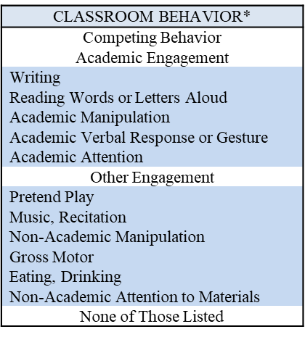
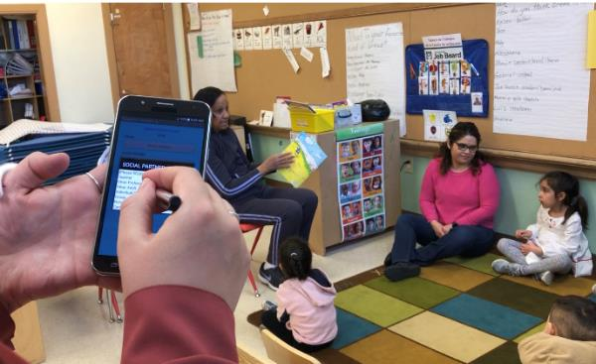
Data-based Decisions
Monitor Progress Increasing Children’s Literacy Engagement

Slide 32
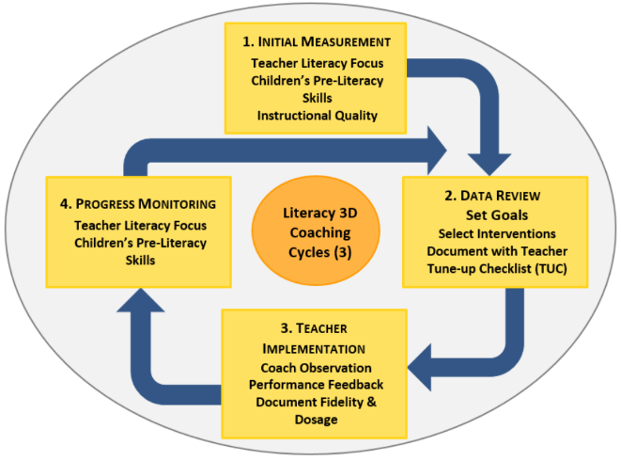
Practice-based Coaching

Slide 33
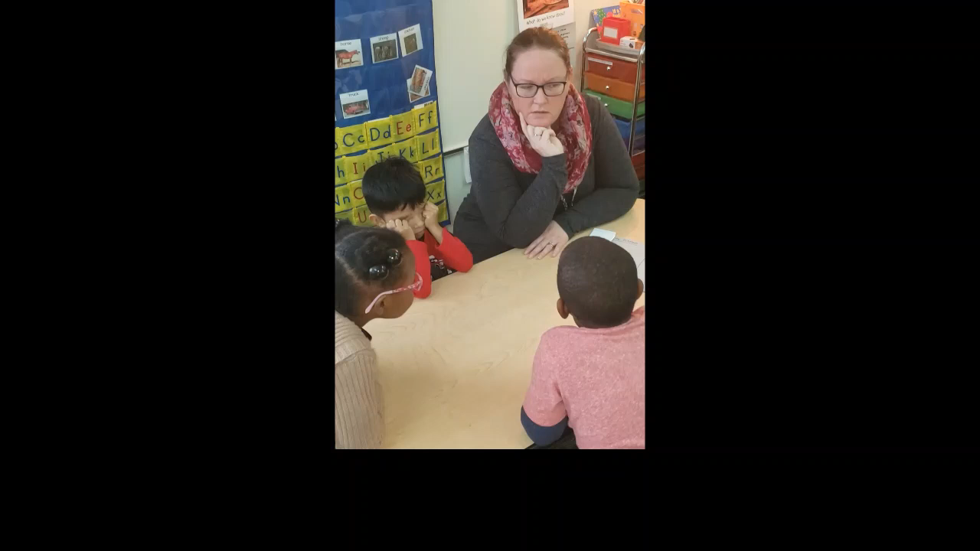
Literacy 3D Example Strategy- Word Bank Game!
Responsive/Engaging Teaching of Vocabulary, Word Comprehension, and Background Knowledge

Slide 34
Break-Out and Report Back
How was the teacher providing multiple opportunities to learn vocabulary in the Word Game?
What literacy engaged behaviors were the children’s using?
How might the Game be adapted for use online?

Slide 35
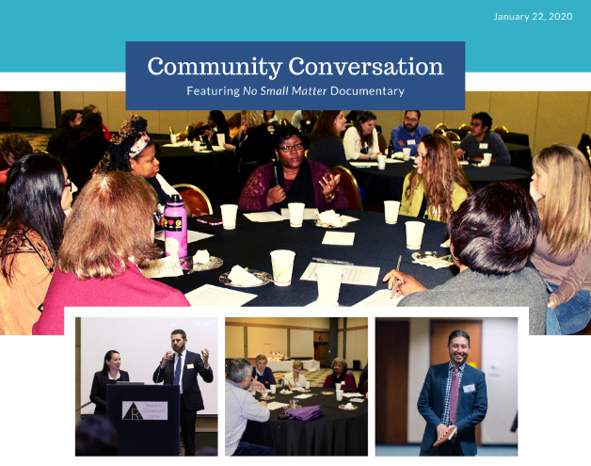
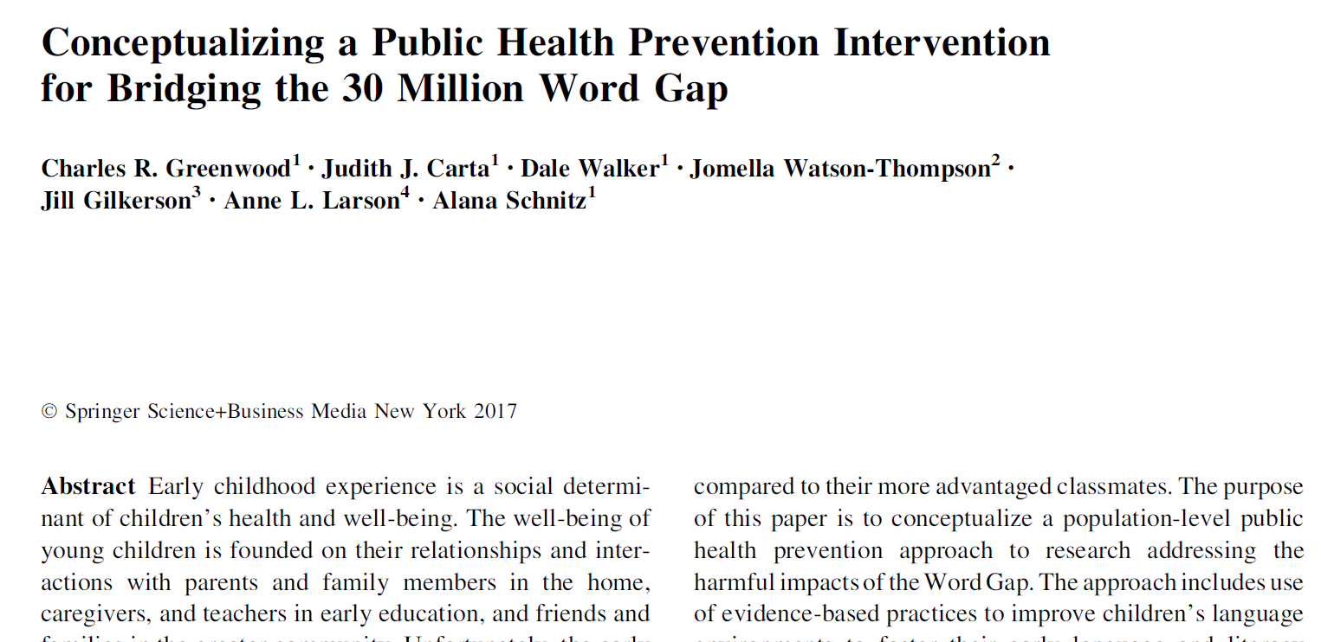
How to Support/Engage an Entire Community

Slide 36
Challenges Communities Face
Awareness of the problem and its implications
  School readiness, reading outcomes, graduation rates……
  Poor individual and community outcomes and their effects on community life
Competing priorities and lack alignment
  Early childhood is a health and educational outcome
  Both heavily influenced by social determinants that are alterable
Lack of leadership
Lack of resources
Lack of human capital

Slide 37

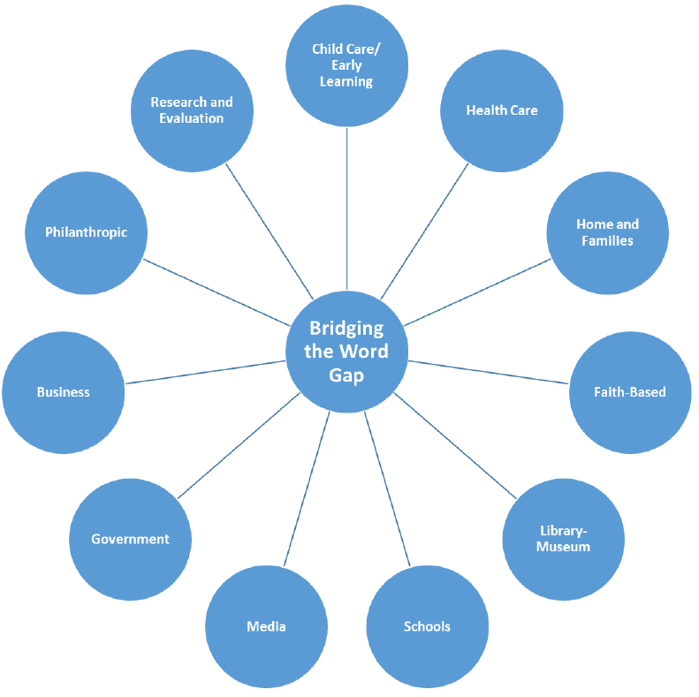
BWG Community Action Planning Guide

Slide 38
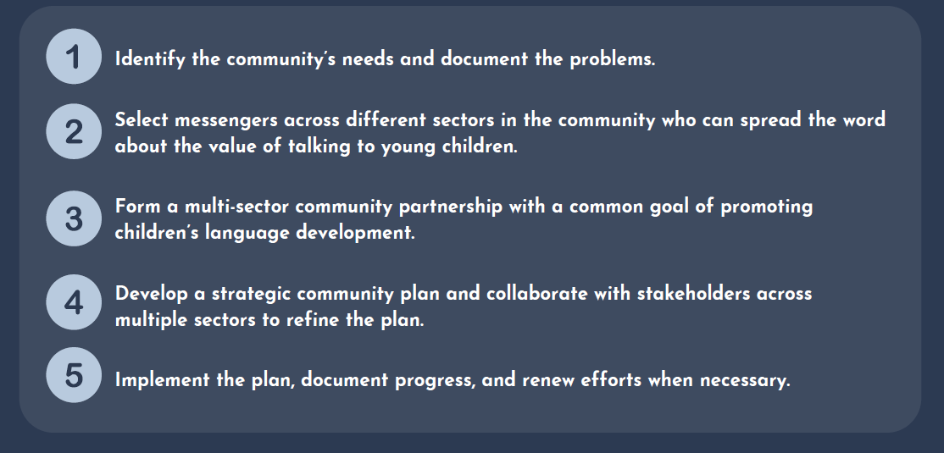
Helps a Community Take these Steps

Slide 39
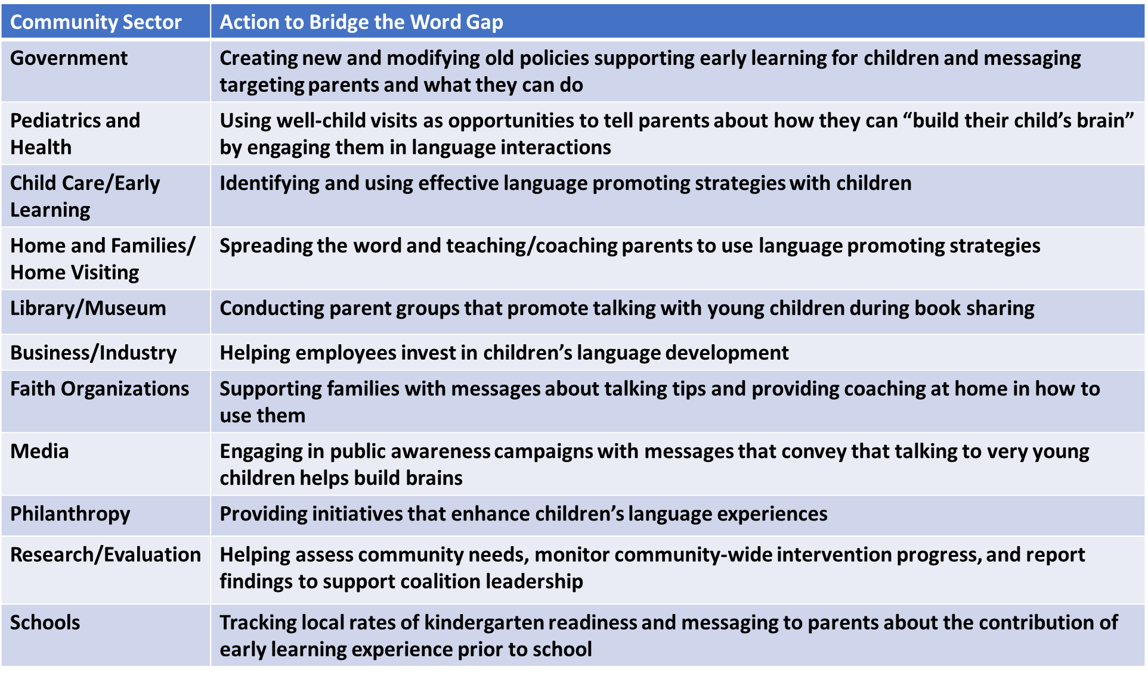
Illustrative Actions Each Sector Can Do

Slide 40
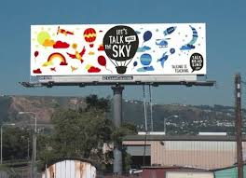
Communities are waging public awareness campaigns -- Too Small to Fail http://toosmall.org/
Notes:
PUBLIC MESSAGING AND ENVIRONMENTAL REMINDERS
Talking is Teaching is an effort by Too Small to Fail, an initiative by Clinton Foundation and the Next Foundation to help parents learn how to use everyday activities as opportunities to promote language: talking and interacting with their child, and teaching them new words in the car, on the bus, in the supermarket, walking through the neighborhood

Slide 41
Break-Out and Report Back
What can you do tomorrow to engage the entire community in language and literacy promotion?
How does language and literacy promotion fit with other health priorities in communities, cities, states?

Slide 42

Take-Aways from this Talk!
Poverty promotes an inequity in children’s language and early literacy experience beginning at birth (if not earlier)
Covid-19 exacerbates the problem!
A child’s language learning starts at birth in the home and extends to other settings and persons with age
You and I are responsible for designing children’s language and literacy learning environments
Effective interventions exist for use at the child, family, child care, preschool, school, and community levels of influence and resource

Slide 43
Conclusion
Start language and literacy promotion at birth with parents at home, don’t wait – find the means (levers of change)
“One size fits all” strategies of addressing young children’s needs are not effective
Evidence-based strategies exist for meeting all children’s needs in their homes, child care, preschools, schools, and communities
Prepare community members and EC professionals with this knowledge and skill to address effective environments for the life span relevant to learning and teaching
Consider adaptations for use during the Covid-19 time

Slide 44

Q & A – Discussion Question
What is one thing you heard today that you can use tomorrow?
  Send your response in the Chat Tool!

Slide 45
Recommended Online Resources
Juniper Gardens Children’s Project (JGCP) - https://juniper.ku.edu/juniper-about
Bridging the Word Gap Research Network (BWGRN) - https://bwg.ku.edu/
Promoting Communications Strategies (PC-TALK) - https://talk.ku.edu/
Infant/Toddler Individual Growth and Development Indicators (IGDIs) Web - https://igdi.ku.edu/
Preschool Literacy at JGCP - https://earlyliteracy.ku.edu/
Promoting the Success of Dual Language Learners (Habla DLL) – https://www.habladll.org/
Preschool Individual Growth and Development Indicators (MyIGDIs) - https://www.myigdis.com/preschool-assessments/early-literacy-assessments/
Classroom Positive Behavior Support (CW-FIT) - https://cwfit.ku.edu/

Slide 46
Contact Information
Charles Greenwood, PhD
  greenwood@ku.edu
Alana Schnitz, PhD
  aschnitz@ku.edu
Dwight Irvin, PhD
  dwirvin@ku.edu
Dale Walker, PhD
  walkerd@ku.edu
Judy Carta, PhD
  carta@ku.edu
Juniper Gardens Children’s Project
  https://juniper.ku.edu/

