Slide 1
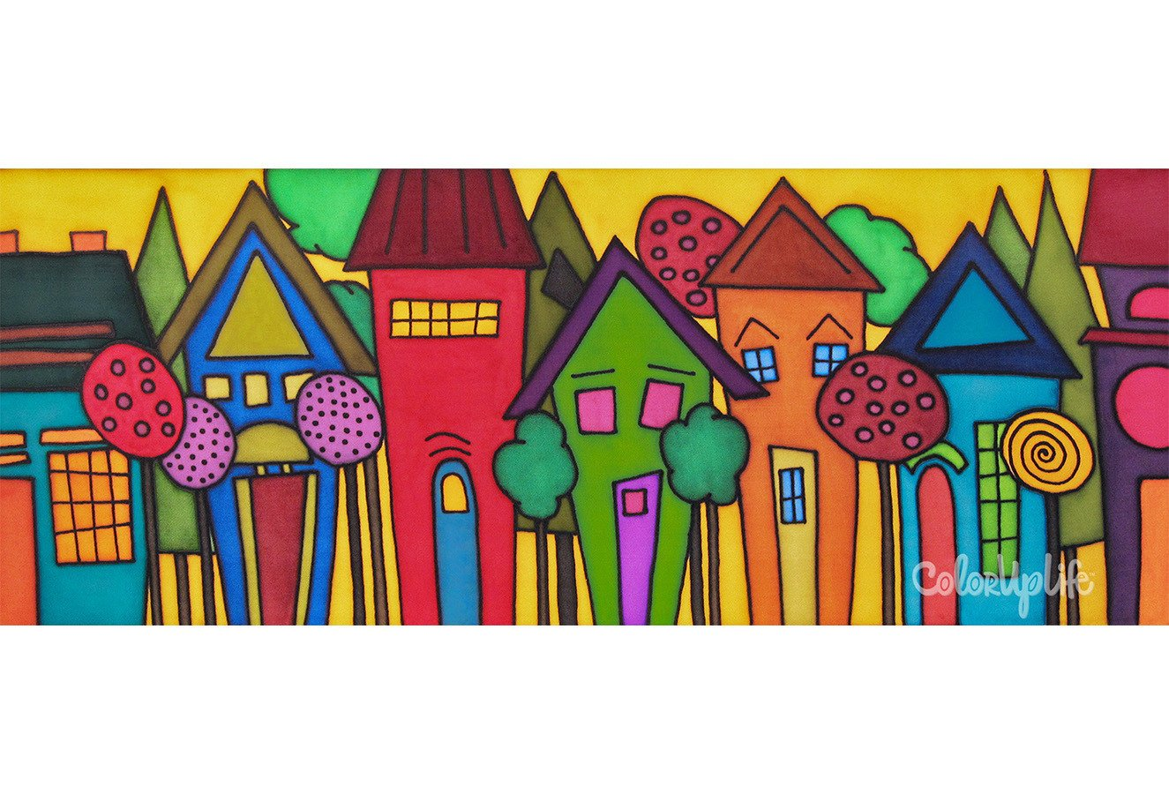
Creating more nurturing learning environments for young children growing up in poverty in the age of Covid-19
Virginia Cross-Sector Professional Development Higher Education Faculty Institute
October 16, 2020
Judith Carta, Ph.D.
Juniper Gardens Children’s Project
University of Kansas
carta@ku.edu

Slide 2
My humble thanks to all of you heroes!

Slide 3
Questions for the day:
What do we know about poverty and children’s development?
How does poverty exert its toxic effects on children’s development and learning?
How is the pandemic magnifying the harmful effects of poverty on young children?
How can we foster children’s resilience by creating more nurturing learning environments for young children?

Slide 4
Poverty exerts a heavy toll on children’s development.
Many studies show that children who grow up in poverty are more likely to show significant delays in learning and development.
The association between poverty and development occur across multiple outcomes: Language, cognitive, social, behavioral, and health.
The association has been documented frequently in the literature and as early as 9 months of age.
The gap continues through the school years and the gap continues to grow.

Slide 5
The Achievement Gap “Catching Up is Hard to Do”
Children from
Mid SES
School Readiness
Ready
B
Not Ready
A
D
Children from
Low SES
C
Can Read Fluently
Birth
5ys 10ys
18ys

Slide 6
Indirect Effects on Poverty on Children
Child
Poverty
Family
Notes:
Effects of poverty are felt through disruptions in family functioning (Elder & Caspi, 1988)
Economic hardship linked to increased family stress; negative impact on mental health; greater likelihood of harsh and controlling parenting; increased child behavior problems

Slide 7
The Gap Shows Up Early
1200
College Educated Parents
600
Working Class Parents
Cumulative Vocabulary (Words)
Welfare Parents
200
16 mos.
24 mos.
36 mos.
Child’s Age (Months)
Source: Hart & Risley (1995)
Notes:
Meaningful Differences
Ross has already told you about the scientific basis for the achievement gap. I want to show you a little more about what this actually means to the child.
Differences in vocabulary growth between children in low socio-economic households and high socio-economic households begin to appear as early as 18 months. And as the children grow toward school age, and enter school, the differences only get larger in the absence of intervention.
By the time a child with parents living on welfare is 3 years old, his or her vocabulary gap is enormous compared to a child with college-educated parents.
Number of words (30 million) → Interaction behind the words
Representational vs. Directional Language
Internal working models → School behavior
Purple Grape Story
Joint attention

Slide 8
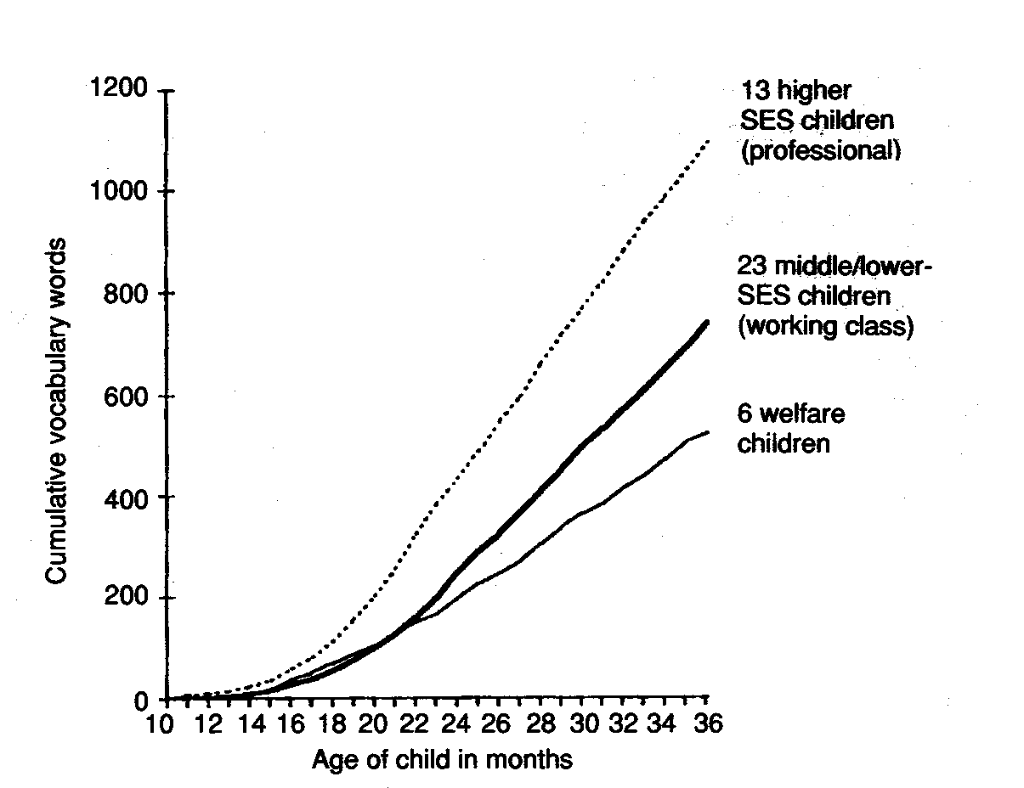
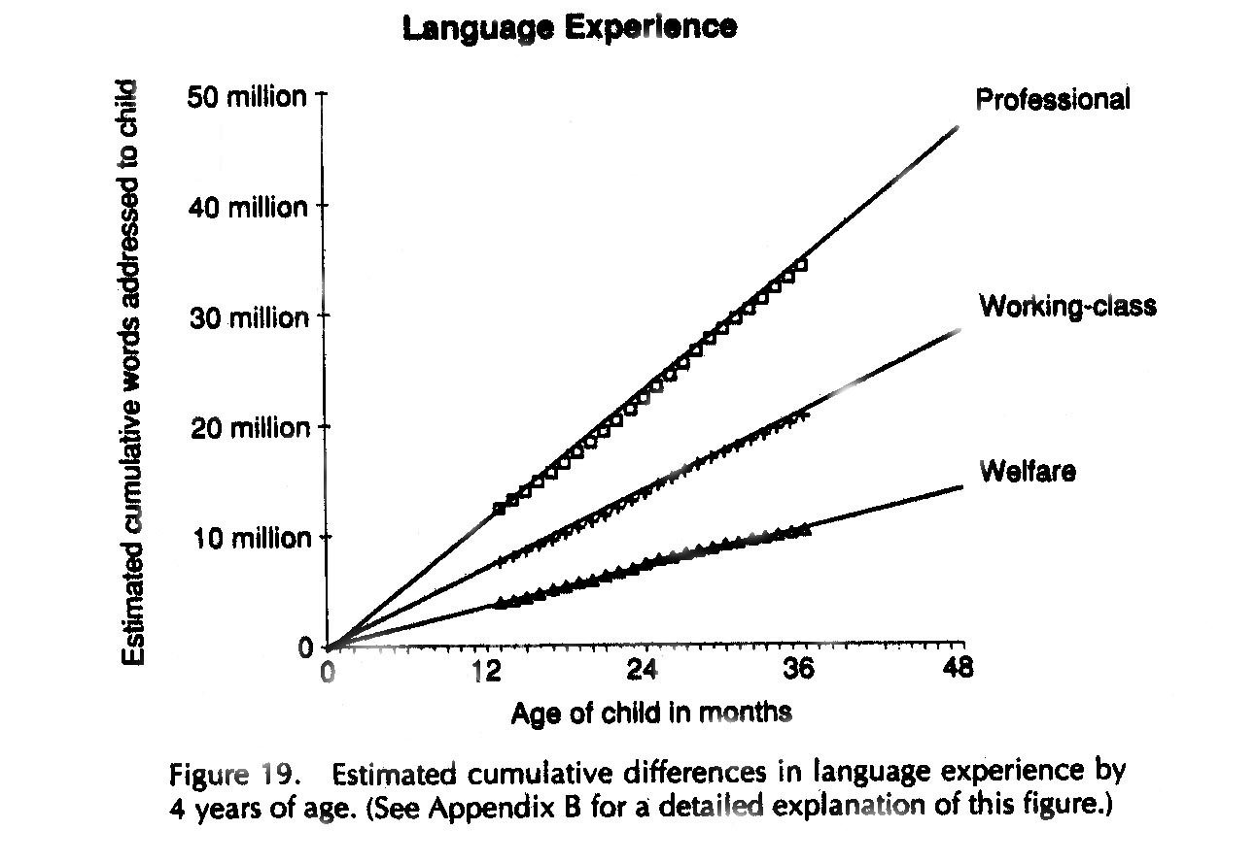
The 32-million word gap by age 4
Children from professional, working class and welfare-receiving families had very different experiences in terms of their exposure to number of vocabulary words.
Gap grew enormously over time.

Slide 9
Many environmental factors can interfere with children’s development.
Many children are exposed to risks that we know affect later development
High levels of parental stress
Parental depression
Substance abuse
Domestic violence
Community Violence
Structural racism
Inadequate nutrition
Unavailable health care
Cumulative risks compound the likelihood of adverse outcomes

Slide 10
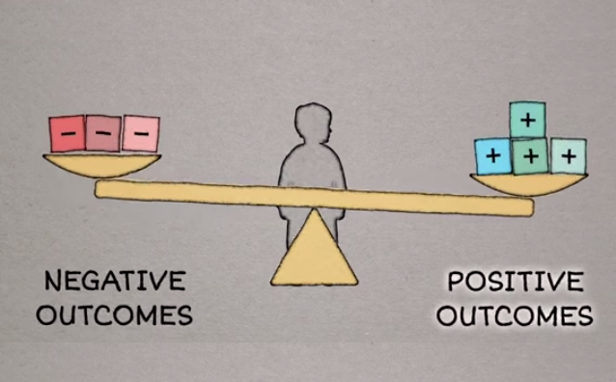
Each additional risk tilts the scale towards a child’s negative outcomes

Slide 11
Number of Risks in First Three Years Predicts Developmental Delay
Barth et al (2008). Credit: Center on the Developing Child.

Slide 12
Poverty affects brain development.
Sara B. Johnson, Jenna L. Riis and Kimberly G. Noble
Pediatrics April 2016, 137 (4) e20153075; DOI: https://doi.org/10.1542/peds.2015-3075

Slide 13
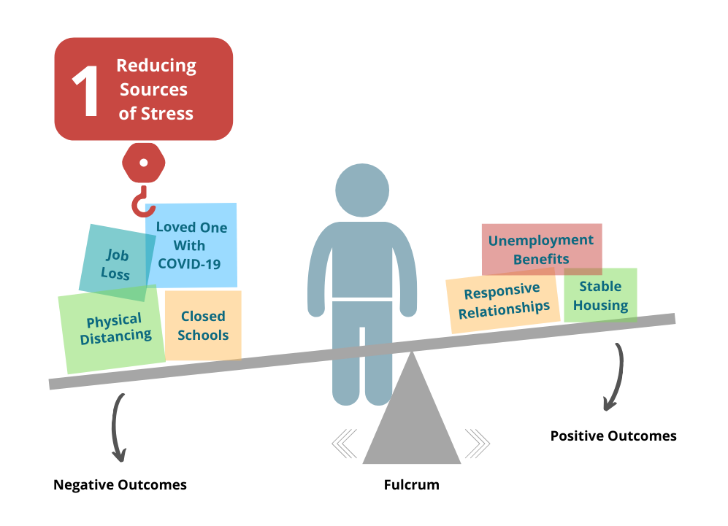
Center on the Developing Child at Harvard University

Slide 14
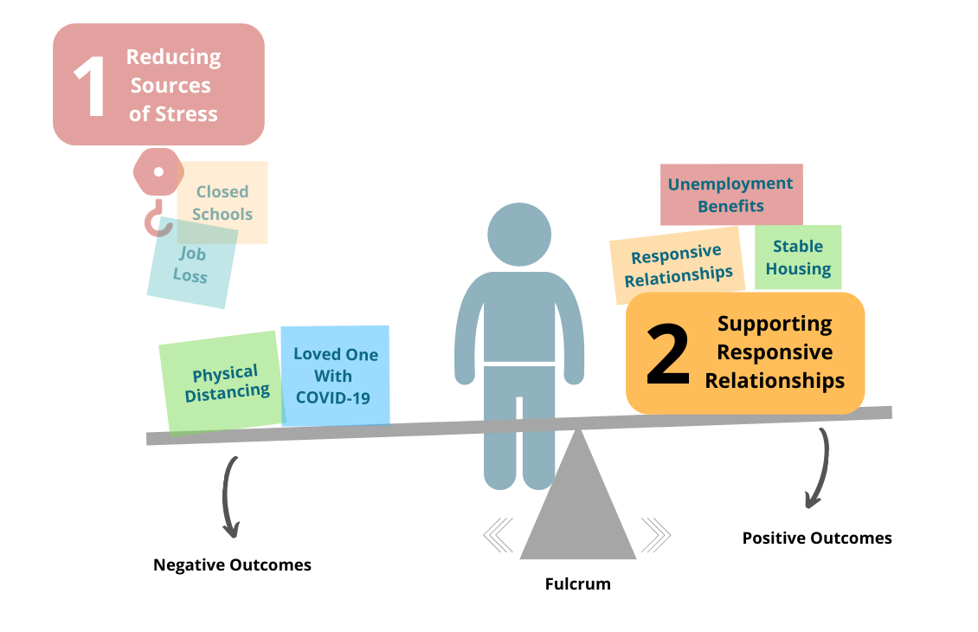
Center on the Developing Child at Harvard University

Slide 15
How Risk and Protective Factors Affect
Children’s Learning Outcomes
Multiple risks
Factors associated with school readiness
Weak social support
High Quality Classrooms with Strong Instructional Support
Ready to learn
Supportive Relationships
with Parents and Caregivers
Talking and Reading
to Child
Responsive
Caregiving
Birth
Late Infancy
Late Toddler
Late Preschool
6 mo 12 mo 18 mo 24 mo 3 yrs 5 yrs
Age
Early Infancy
Early Toddler
Early Preschool

Slide 16
The Covid Effect on Children: How it explodes the effects of poverty

Slide 17
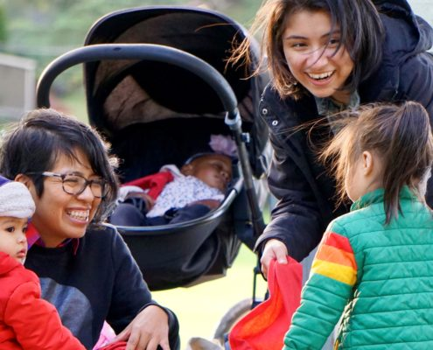
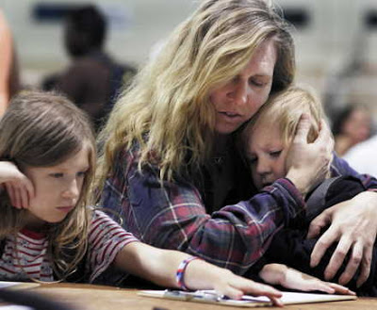
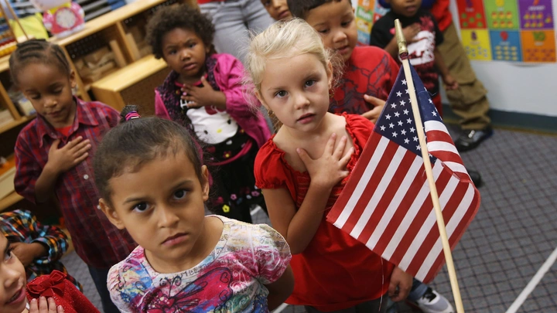
Covid-19 is not an equal opportunity pandemic
Families who are poor and families of color are much more likely to feel the adverse effects.
Educational experiences of children in poverty will be differentially affected.

Slide 18
FOOD INSECURITY
INCREASES IN DOMESTIC VIOLENCE
LOST LEARNING
OPPORTUNITIES
COVID-19 WILL EXPLODE ACHIEVEMENT GAPS IN EDUCATION
CHILD CARE UNAVAILABLE
SOCIAL ISOLATION
DIGITAL DIVIDE

Slide 19
Why families in poverty are more likely to be hit harder by the pandemic
Greater likelihood of family members contracting Covid-19
Costs of caring for sick family members
Loss of wages, housing
Food insecurity
Higher likelihood of families in essential jobs but limited child care availability
More densely populated households
Less likely to have broadband and capacity to connect to school
Structural racism magnifies these disparities.

Slide 20
How these family stresses can affect children
Can affect family members’ mental health (depression and anxiety)
Increase risks for domestic violence and child abuse and neglect
Make it more difficult for families to engage in responsive interactions with children

Slide 21
Recovery from the pandemic will take longer for families and children in poverty
It will take longer for families to recover from the economic downturn.
Access to quality child care and early educational opportunities will take longer
The “learning gap” for children in poverty will only increase in time without intervention.

Slide 22
How the pandemic may affect early education for children in poverty
Child care/early education may close removing an important source of stability/predictability in some children’s lives.
Children will lose important opportunities for social interaction.
Children will lose out on important learning opportunities.
Some children will not have access to healthy meals and health surveillance that are often available in child care/early education.
Child care providers/early educators are stressed trying to address the learning needs of their children.

Slide 23
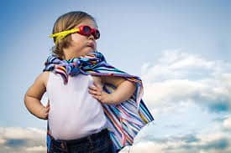
Important to remember…
Some children will be resilient.
Not all children will be adversely affected.

Slide 24
Some children will be resilient.
Not all children will experience all risks
Some families will have protective factors that blunt the effects of poverty-related risks
Concrete support: Some parents will access to basic needs, services and supports
Some families will be RESILIENT and have ways to manage stress in face of adversity
Some families will have deep family and community and faith-based connections that provide support.
Some families will have knowledge of parenting and child development
Some families will continue to provide responsive interactions with children that foster development
Some children will continue to get early educational support and instruction from education, child care, early intervention.

Slide 25
Resilience: How Can We Promote Children’s Resilience during the Pandemic and Afterwards…
Some thoughts about resilience. . .
Resilience isn’t something we’re born with.
Resilience is a product of our experiences over time and how experiences interact with our genetic makeup.
The way we respond to adversity depends on the balance scale and how the negative and positive experiences balance out.
We can promote more nurturing early experiences by UNLOADING THE NEGATIVES and INCREASING THE POSITIVES.

Slide 26
Center on the Developing Child at Harvard University

Slide 27
BREAKOUT QUESTION:
How can we tip the balance and help more children be resilient?
Identify 2 or 3 ways that we can promote the resilience of young children in poverty.
What can we can do to
Unload the NEGATIVE-reduce the stressors
Load up on the POSITIVE
Center on the Developing Child at Harvard University

Slide 28
What Can WE do to reduce the effects of poverty-related adversity on children’s development?
How can we promote RESILIENCE in children?

Slide 29
Center on the Developing Child at Harvard University

Slide 30
HOW CAN WE UNLOAD THE NEGATIVES?
Programs can share resources with families on where to go to get help to meet their basic needs, diapers, child care, internet access.
Programs can steer parents towards support they need (financial, medical, mental health)
Programs can give parents a break by giving them some grace about engaging the children in remote learning.
Programs can encourage parents and their educational staff to practice self-care. Take some minutes every day for themselves, getting plenty of rest.

Slide 31
HOW CAN WE LOAD UP ON THE POSITIVES?
Emphasize supportive and responsive interactions with children and families
When re-opening schools, use specific strategies to connect with families and for welcoming back children (help them know what to expect)
Create a safe and predictable environment for children (remind them or teach them rules, routines)
Develop strategies for children to address stresses at school: unexpected events (new teachers, different classrooms, wearing masks, staying at home and quarantining)

Slide 32
Great Resources for Promoting Children’s Social-Emotional Development
Pyramid Model: National Center for Pyramid Model Innovation: http://challengingbehavior.cbcs.usf.edu/
Incredible Years: http://www.incredibleyears.com/parents-teachers/
The PATHS® Curriculum: http://www.pathstraining.com/main/curriculum
First Step to Success: http://www.firststeptosuccess.org/.
Best in CLASS: https://education.ufl.edu/best-in-class/

Slide 33
Poll question: What should teachers prioritize as they re-establish their connections with children?
Re-establishing a schedule
Helping children remember or learn the classroom routine
Engaging in positive conversations across all activities
Establishing classroom expectations and rules
Providing children with emotional support and strategies for regulating their emotions
Helping children interact with their peers

Slide 34
National Center for Pyramid Model Innovation
https://challengingbehavior.cbcs.usf.edu/

Slide 35
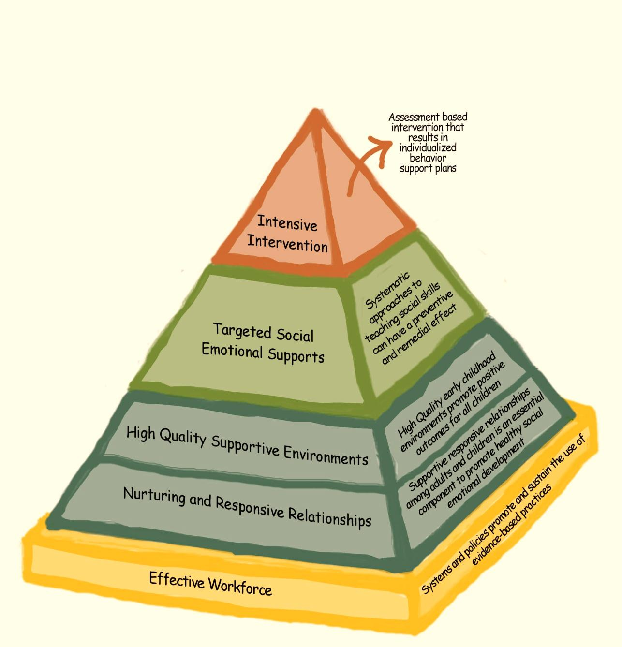
Relationships: The Foundation of the Pyramid
Notes:
Changed Visual-MJ
The Pyramid Model provides a conceptual framework for the evidence-based practices that are used to promote the healthy social development of all young children. The first tier of the model, promotion practices, describe the strategies that are used to promote and support the optimal social development of all children. The prevention tier of the model includes targeted, social emotional supports that are provided to the smaller number of children who at risk of social delays and challenging behavior. The tip of the pyramid includes the individualized intervention practices necessary to address the challenging behavior or intervention needs of the very small number of children who have persistent problems or are in need of more intensive support.
35

Slide 36
Establishing Relationships
“Every child needs one person who is crazy about him.” -Uri Bronfenbrenner

Slide 37
During Pandemic, Teachers Need to Prioritize Relationship Building with Families
Have specific strategies for reconnecting with families, welcoming them back, and reassuring them
Maintain regular connections with families is critical and seeing how they and their children are coping
Find out what level of support is needed for families and children.
Know about resources or information that can be shared.
Have strategies in place for children who may not be able to attend .

Slide 38
During Pandemic, Teachers Need to Prioritize Relationship Building with Children
Engage in lots of “serve and return” interactions. (when children “serve” (seek our attention with gestures, sounds, words), we need to “return” with our attention and words and actions.
Use positive directions: Important to tell children what to do instead of what NOT to do.
Provide positive descriptive feedback often.

Slide 39
High Quality Supportive Environments
Notes:
Changed visual-MJ
The Pyramid Model provides a conceptual framework for the evidence-based practices that are used to promote the healthy social development of all young children. The first tier of the model, promotion practices, describe the strategies that are used to promote and support the optimal social development of all children. The prevention tier of the model includes targeted, social emotional supports that are provided to the smaller number of children who at risk of social delays and challenging behavior. The tip of the pyramid includes the individualized intervention practices necessary to address the challenging behavior or intervention needs of the very small number of children who have persistent problems or are in need of more intensive support.
39

Slide 40
Classroom Arrangement and Environmental Supports
Physical Design of Classrooms
Environmental Cues
Schedules and Routines
Transitions
Promoting Engagement During Large and Small Group Activities
Simple Rules/Expectations
Ongoing Monitoring and Positive Attention

Slide 42
Teaching New Routines: Socially Distant Greetings

Slide 43
Targeting Social-Emotional Supports for Children Needing More
Notes:
Changed visual-MJ
The Pyramid Model provides a conceptual framework for the evidence-based practices that are used to promote the healthy social development of all young children. The first tier of the model, promotion practices, describe the strategies that are used to promote and support the optimal social development of all children. The prevention tier of the model includes targeted, social emotional supports that are provided to the smaller number of children who at risk of social delays and challenging behavior. The tip of the pyramid includes the individualized intervention practices necessary to address the challenging behavior or intervention needs of the very small number of children who have persistent problems or are in need of more intensive support.
43

Slide 44
Helping Children Learn and Practice Social Skills While Social Distancing

Slide 45
Strategies for Promoting Social-Emotional Skills
Make emotional literacy a teaching priority.
Help children learn to identify and express their emotions.
Help children identify emotions for staff wearing masks.
Have a classroom “feelings check-in” to start the day.

Slide 46
During Pandemic, Teachers Need to Promote Social Emotional Skills
Work on emotional literacy with a “feelings check-in”

Slide 47
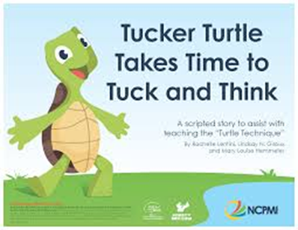
During the pandemic, teachers should be prepared with strategies for children who are anxious, distracted or who have lower frustration thresholds.
Offer more choices
Reduce expectations for time on task
Provide children with extra support during difficult routines such as transitions or clean-up.
Provide children with strategies for calming, self-regulation.
.Have strategies for teaching self-regulation.
Tucker Turtle.
Places to go to calm down.
Strategies for self-regulation (visuals for practicing deep breathing).

Slide 48
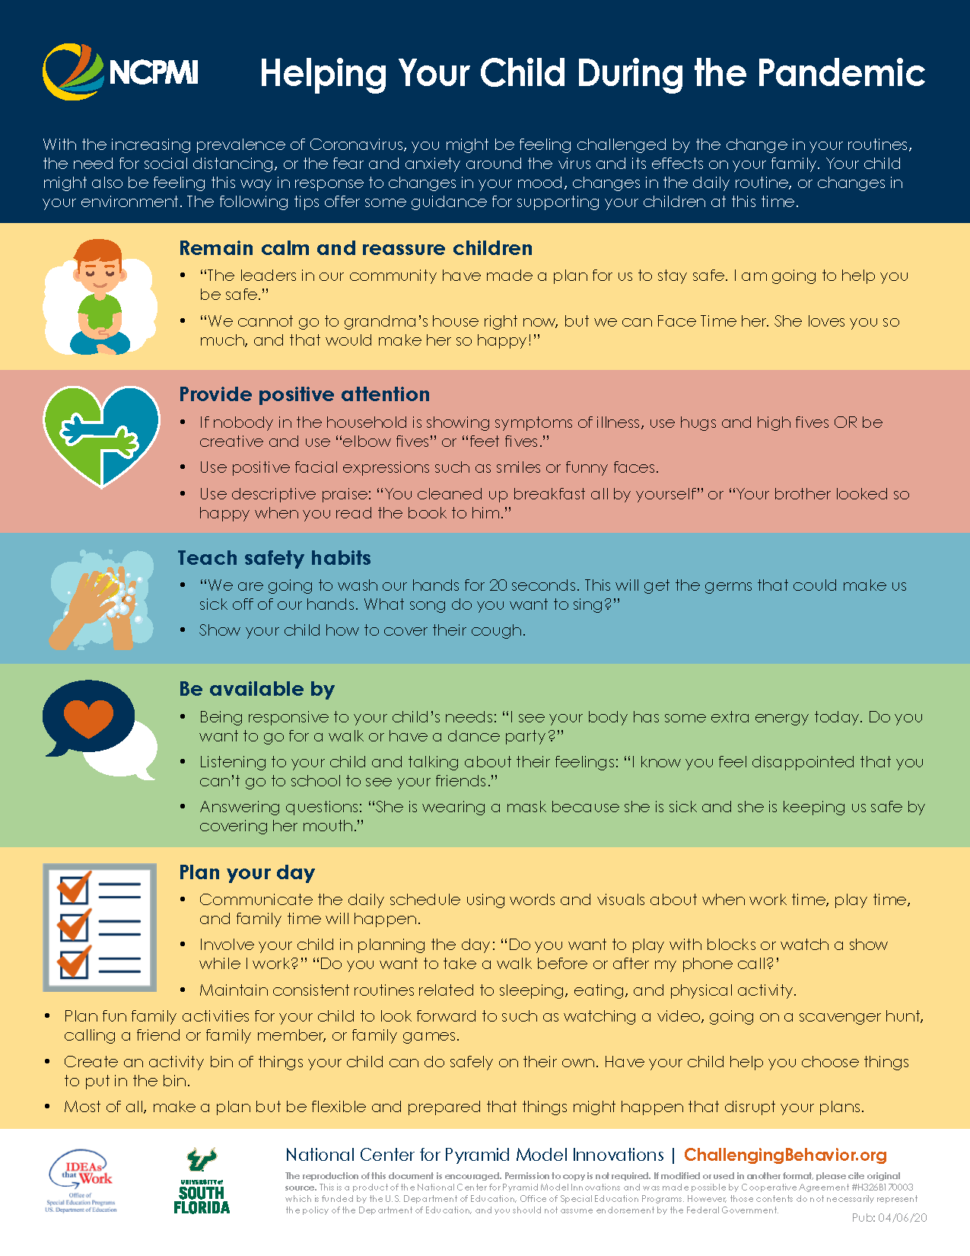
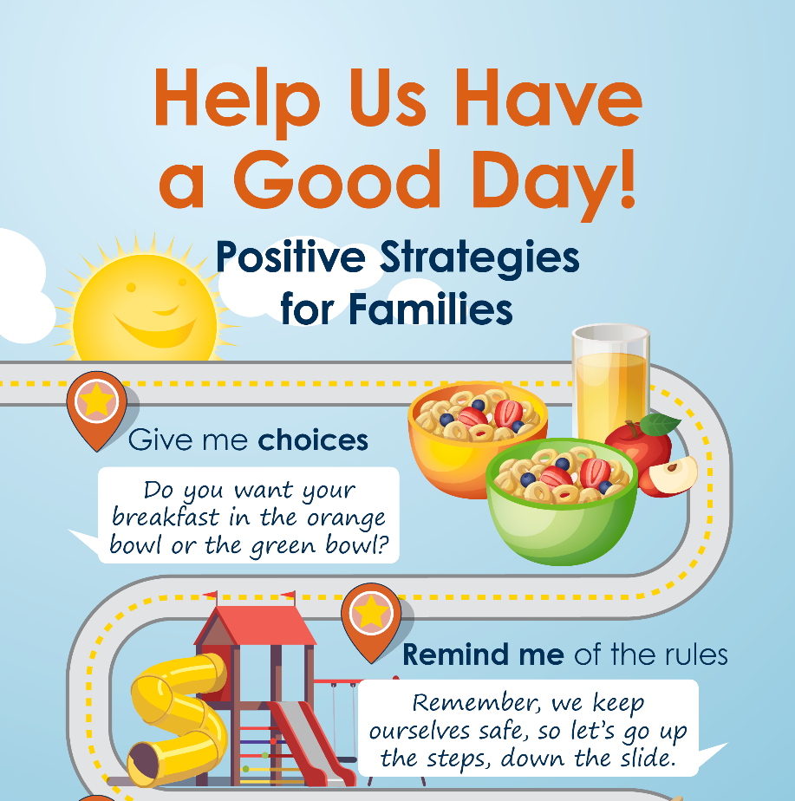
Important to Continue Supporting Families with Strategies

Slide 49
Finding Children in the River: A Parable About Prevention

Slide 50
What we do each day with children helps build their resilience.

